Slide 1

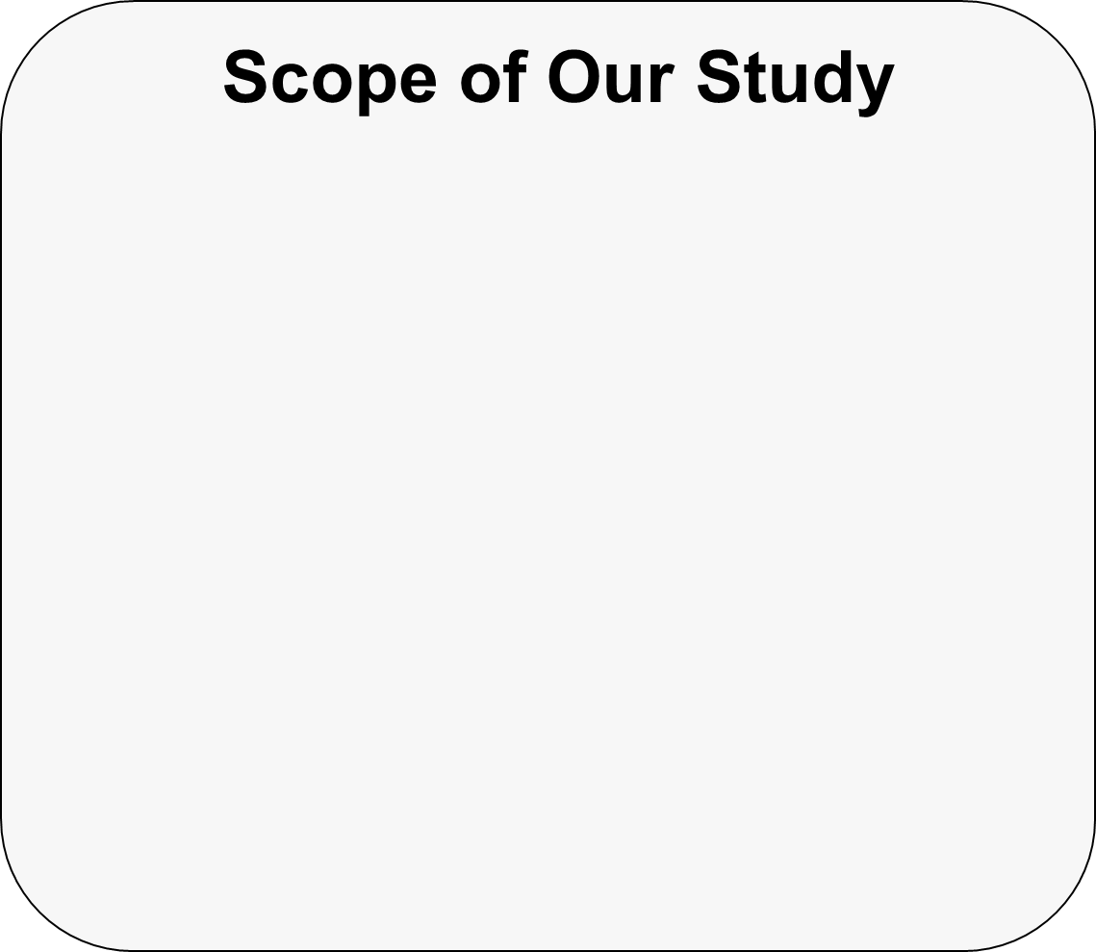

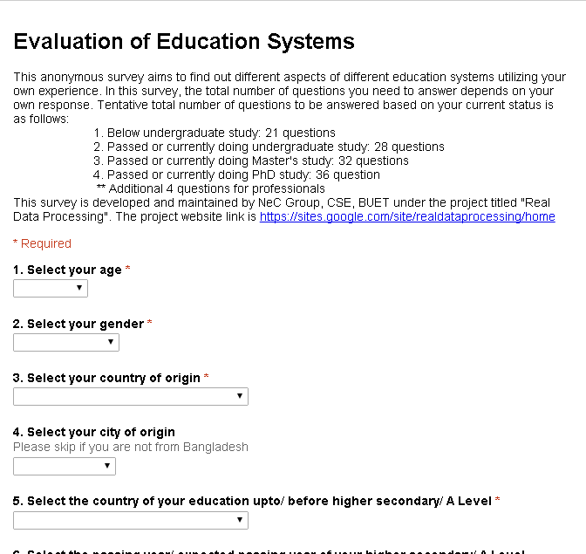
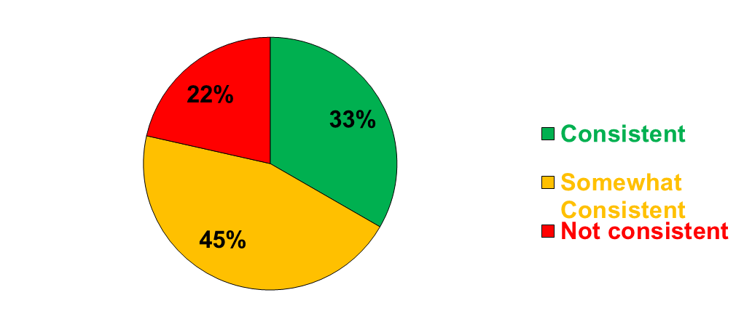
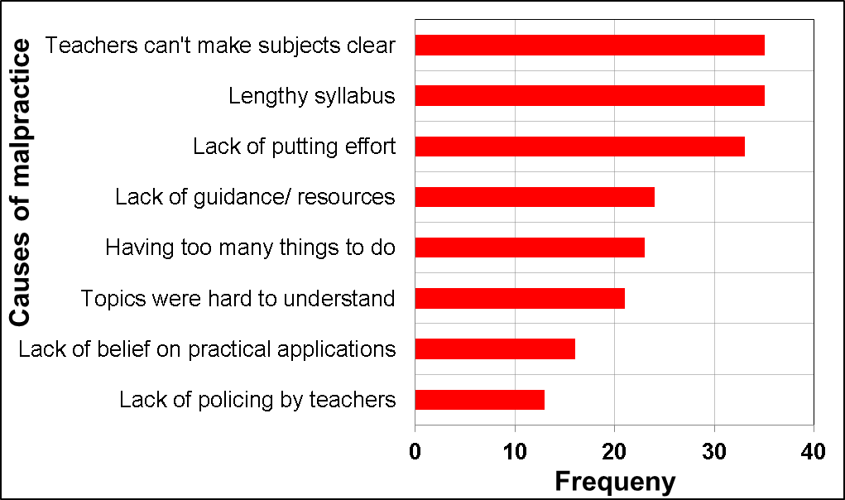
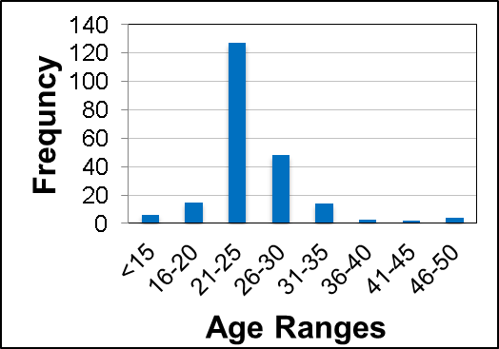
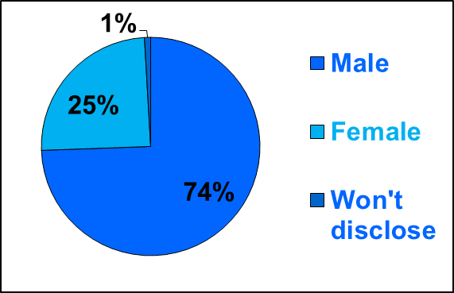
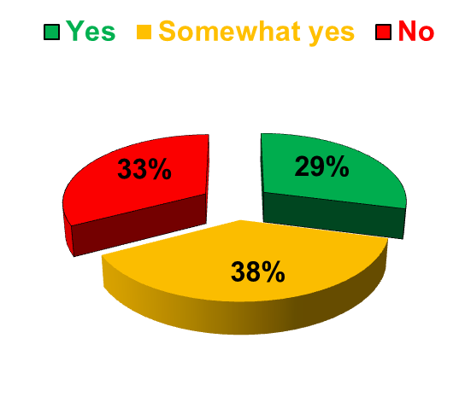
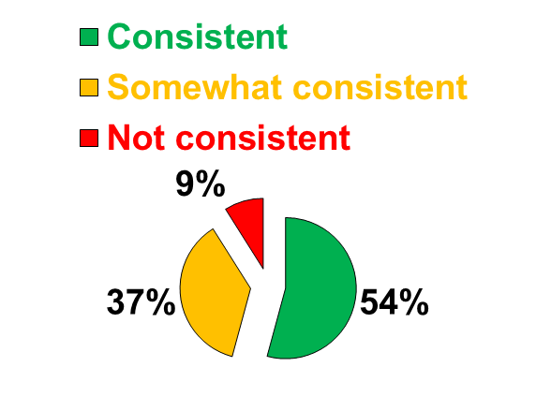
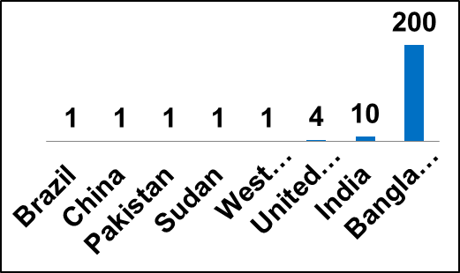
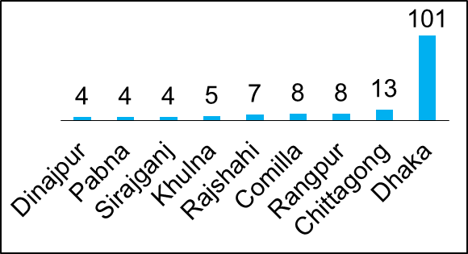
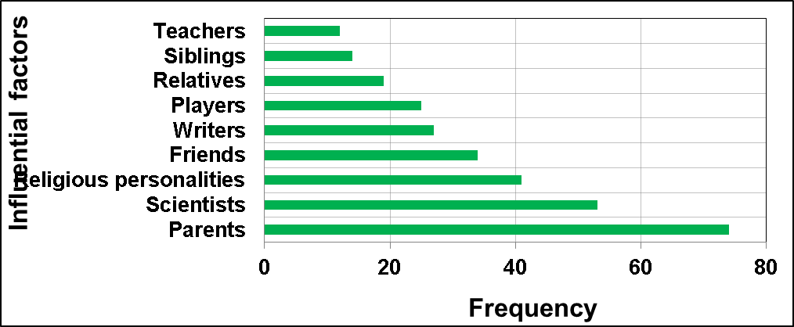
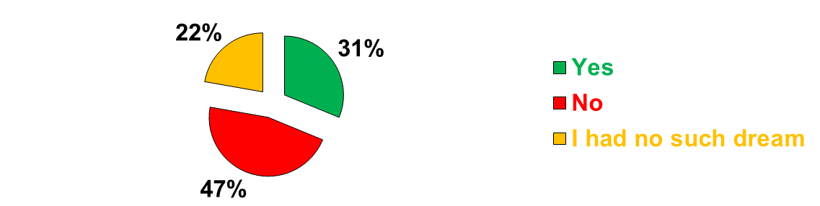
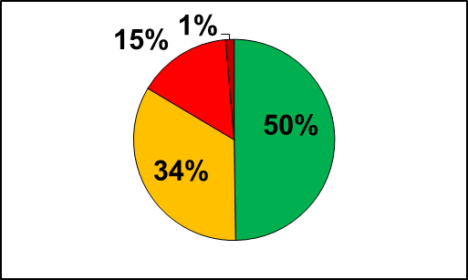
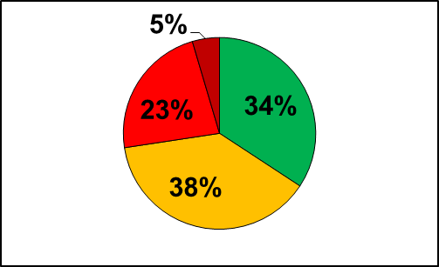
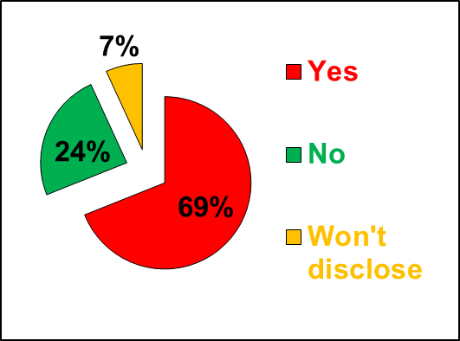
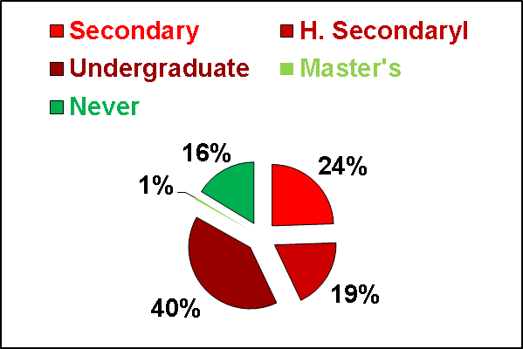
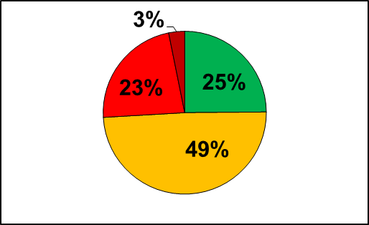
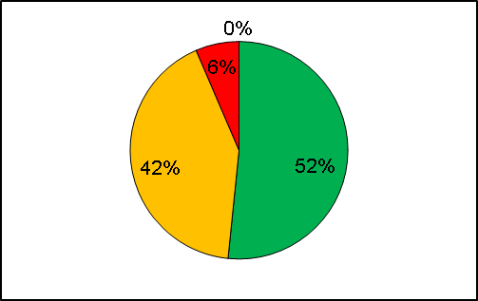
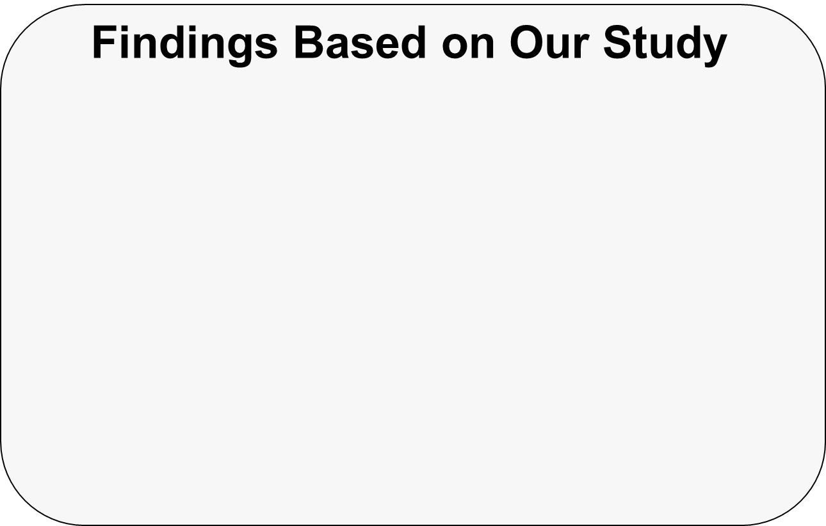

A Tale of Institutional Education:
Students’ Perspective
Muhammad Hussain Mahdi
Email: 0905008.mhm@ugrad.buet.ac.bd
Motivation of Our Study
Institutional Education plays a vital role in shaping students’ lives.
Conventional educational reforms or initiatives usually do not consider students’ perspectives as one of the determining factors [1].
As students are the major stakeholders of institutional education, improvement (if any) in education system should consider their opinions first.
  However, existing literature is yet to focus on this issue. Therefore, in this work, we attempt to address the issue.
Institutional Aspects: This study reveals the factors that significantly affect the institutional education system.
Students’ Aspects: This study points out the issues related to students’ interest that should be addressed first for any sort of improvement attempts being made.
Other Factors: This study also demonstrates the significance of other factors such as parents, teachers, technology, etc., in education system.
Survey: Both online and off-line.
Factors under our consideration: Educational contents, students’ background, teachers’ roles, other factors, region, and time.
Fig. 1: A snapshot of our survey
questionnaire
(the online version)
Data Collection Summary: We have conducted the survey both online and offline. So far, we have reached 460 responses. This poster shows an analysis on 219 online responses [2].
Survey Results
Q4: Are/ were theory and laboratory contents consistent during your undergraduate study? [Fig 9]
Demography Analysis:
Fig 7: Consistency between theory and laboratory contents in secondary and higher secondary levels
Fig 12: Reasons behind doing malpractice /copying
Response Analysis: Other Factors
Fig 2: Age demography
Fig 3: Gender demography
Q8: Who are/ were your role models or inspiration of life? [Fig 13]
Fig 4: Responses from different countries
Fig 5: Responses from different regions of Bangladesh
Fig 8: If studies up to higher secondary are consistent with that of undergrad level
Fig 9: Consistency between theory and laboratory contents in undergrad level
Response Analysis: Students’ Vision
Response Analysis: Malpractices
Fig 13: Influential factors for students
Q1: Did you dream about the same subject from your childhood, which you are/ were studying during your undergraduate life? [Fig 6]
Q5: Did you ever do any malpractice, such as giving proxy, letting others to copy your own contents, or doing copy from others, during your student life? [Fig 10]
Q9: How is/ was your relationship with your teachers/ instructors during your student life? [Fig 14]
Q6: In which level(s), you have/ had a tendency to copy or do malpractice from others? [Fig 11]
Friendly
Somewhat friendly
Not friendly
Extremely Bitter
Fig 6: Existence of dream among the students
Response Analysis: Educational Contents from the Institutions
In secondary level
In higher secondary level
Q2: Are/ were theory and laboratory contents consistent during your secondary/ O Level and higher secondary/ A Level studies? [Fig 7]
Q3: Do/did your studies up to higher secondary level provide you sufficient background knowledge about the field of your undergraduate study? [Fig 8]
Fig 10: Extent of malpractices
Fig 11: Levels at which students copy the most
Q7: What are the reasons of doing malpractice? [Fig 12]
In undergrad level
In master’s level
Fig 14: Relation of students with teachers
Most of the students lack dream or vision for their future lives.
Consistency between theory and laboratory contents are under question mostly in secondary and higher secondary levels.
Studies up to higher secondary level somewhat lack consistency with that of undergraduate level.
There exist significant extent of malpractices among the students mostly in undergraduate level.
Parents exhibit a major influence on the students.
This study presents an analysis on institutional education from the students’ perspective.
While reforming the education system, factors such as inconsistencies in contents,
relationship of students with teachers, involvement of parents, etc., should be considered with utmost significance.
In our future work, for a more rigorous analysis, we plan to implement ethnographic model and evaluation of the institutional education.
References
[1] Edith Hooge, Tracey Burns, & Harald Wilkoszewski, “Looking Beyond the Numbers: Stakeholders and Multiple School Accountability”, OECD-France, 2012.
[2] Evaluation of Education Systems, http://goo.gl/NuFWAT
Department of Computer Science and Engineering (CSE), BUET

